Slide 1

Employers Supporting Carers
October 2nd 2020 University of Huddersfield

Slide 2



What we mean by the term carer?
Juggling work & caring
Questions when caring?
Carers rights
Carers assessment
What support is available locally?

Slide 3
Carer Wellbeing
Advocacy- Getting your voice heard and understanding choices
Information & Advice
Benefits
Mental Health Service for Carers
Carers Count Website www.carerscount.org.uk
Facebook & Twitter
Telephone 0300 012 0231 9.00-5.00 Monday to Friday

Slide 4
Carers Trust Mid Yorkshire
Support Services:
Weekly breaks / Support in the home
Group support sessions
Bathing Service
Emergency Carer Support
Tel: 01484 537036 (office) Email: info@CTMY.org.uk
www.carerstrustmidyorkshire.org.uk

Slide 5







Introduction to the Digital Resource for Carers (DRC)
The DRC is a comprehensive solution that brings together Carers UK’s digital products and online resources into a single webpage to help carers at the click of a mouse.
Local resources have been added to this to promote support for carers in Kirklees creating an all-inclusive, information resource.
Carers in Kirklees can access the webpage entirely free of charge, helping carers before reaching crisis point.
What is included:
Health & wellbeing
Support for caring
Technology & caring
Financial planning
Working & caring
Your own
resources

Slide 6
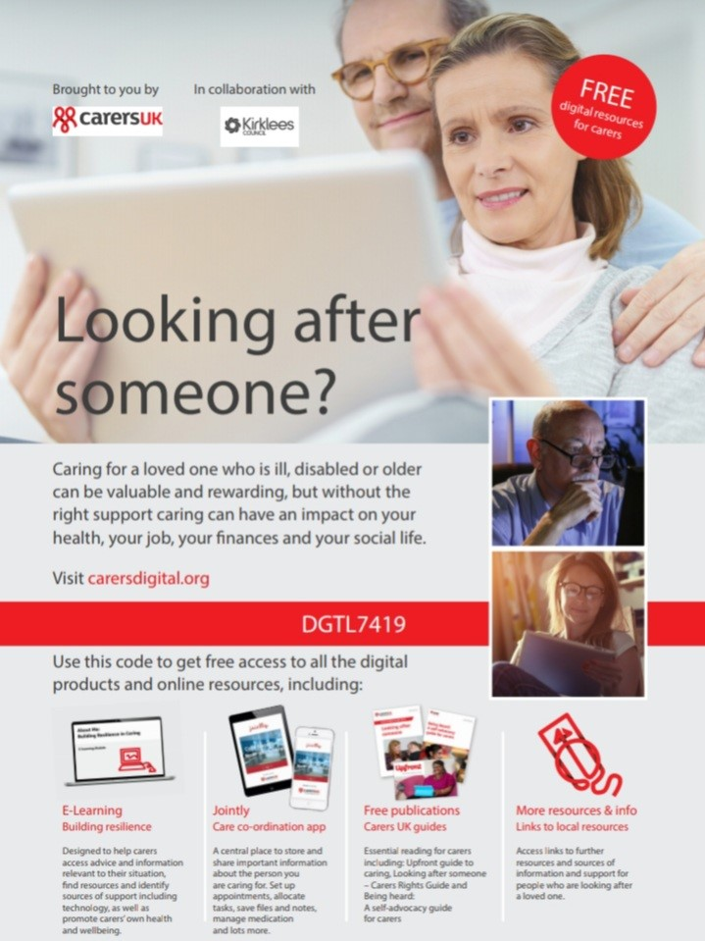
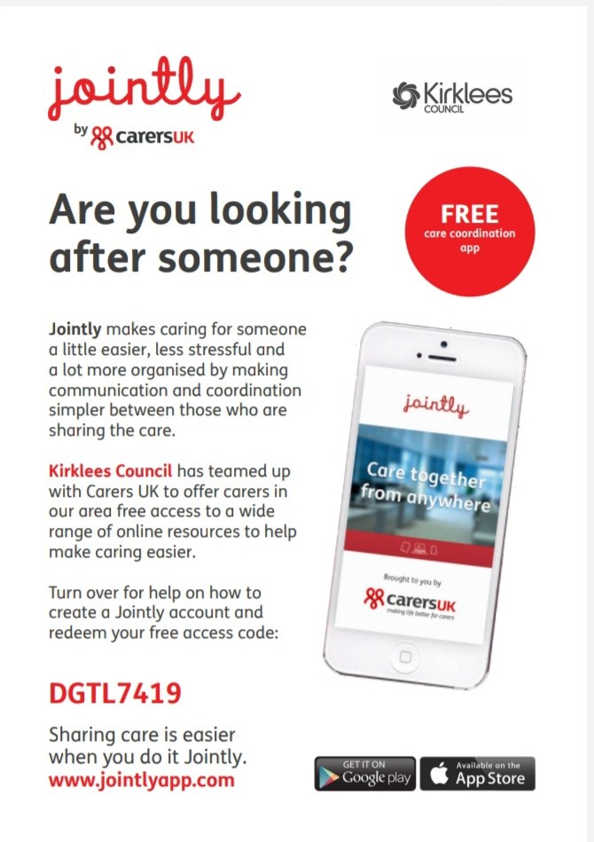
Carers Digital Support

Slide 7
Local Carer Support
Carers Count ( Kirklees) – 0300 012 0231 info@carerscount.org.uk
Calderdale Carers-01422 369101 Email; enquiries@calderdale-carers.co.uk
Carers Wakefield & District- 01924 305544
Carers Leeds- 0113 380 4300 Email; advice@carersleeds.org.uk
Barnsley Carers- 01226 288772 Email; BarnsleyCarers@makingspace.co.uk
Bradford and Airedale, Harrogate and Ripon, and Craven districts of Yorkshire- Bradford Office- 01274 449660 Harrogate Office-01423 500555

