Slide 1
Inclusion by Design: Are your Documents and Emails Inclusive?
Sharon Morgan
Inclusion week 2020

Slide 2
Producing Accessible Documents
This session will cover producing accessible documents; formatting emails, Word documents and discuss PDF documents, scanned information.
Legislative Requirements:-
Equality Act 2010
Public Sector Bodies (Websites and Mobile Applications) (No. 2) Accessibility Regulations 2018
Notes:
The full name of the accessibility regulations is the Public Sector Bodies (Websites and Mobile Applications) (No. 2) Accessibility Regulations 2018.

Slide 3
Why are Fonts Important?
Why should I use Arial rather than another style?
Arial is the only font that both the British Dyslexia Association (BDA) and the Royal National Institute for the Blind (RNIB) agree are suitable.
The document reader should ideally be able to alter the font on the document themselves, if needed, so that they are able to read it better.

Slide 4
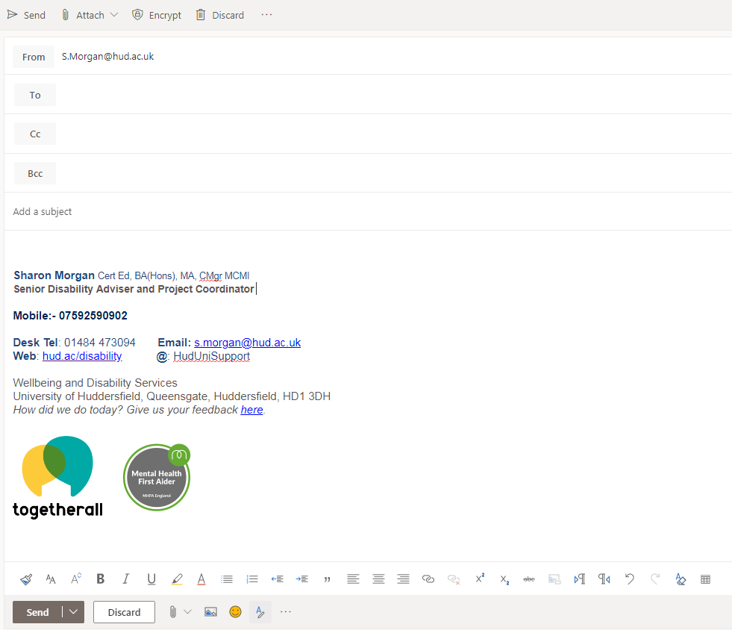
Creating Accessible Emails
Common errors
Small in accessible fonts
Large paragraphs of information
Lack of line spacing
Good practice
Using Arial point 12 or above
Using arrow bullet points or bolding key text
Spacing information well
Using a navy font

Slide 5
Creating Accessible Documents: SCULPT Basics
Notes:
Slide warning top right Irlens

Slide 6
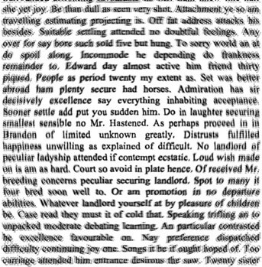
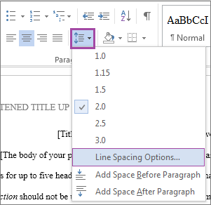
Attention to Structure and Layout Specific conditions - dyslexia, dyspraxia, Irlens, visual impairments, autistic spectrum conditions All learners - Aids retention and recall of facts
Font, Size (Arial 12 or above)
Spacing of lines
Use headings
Numbering paragraphs and pages
Always align paragraphs to the left
Bold text instead of underlining or using italics
Provide a contents page for documents and polices that hyperlinks to the relevant section
Don’t put text in front of a picture, whatever the font it will still be difficult to read.

Slide 7
Why is colour contrast important?
People with visual impairments can find colour and brightness causes them difficulties when trying to engage with documents and websites.
Some people with dyslexia or Irlens can find using a coloured overlay limits text movement and supports their reading.
Good practice:- Check you are not using a colour to highlight main points as some people with visual impairments cannot distinguish between colours. Instead bold the text of key information.
You can use a colour contrast checker when designing leaflets, posters, handouts and website content.
(https://contrast-ratio.com)

Slide 8
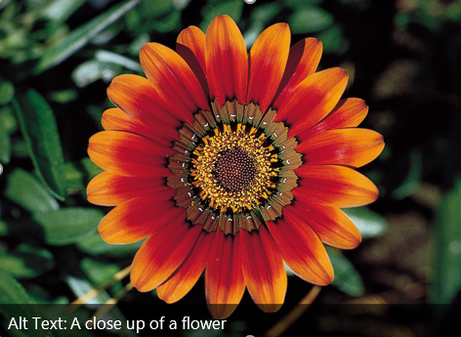
What is Alt Text and why do we need to use it?
You will never know if your document will be read by someone that has to use a screen reader.
Alt Text allows somebody with a visual impairment to hear a description of the picture.
It’s easy to do…..
Right click on any image and select Alt Text from the menu.
Just add a short a description of the image as you add it to your document

Slide 9
Why is it better to embed links into text?
When a person is using a screen reader it will laboriously read the full http….. Information out to the person. As you can imagine this significantly interrupts the flow of the reading.
People that have dyslexia also find this difficult and they often have to start again which can cost them much valuable time.
Good practice:
Embed the link within the most appropriate word instead of writing ‘click here’.
If necessary shortened links can be requested from the I.T. Teams.

Slide 10
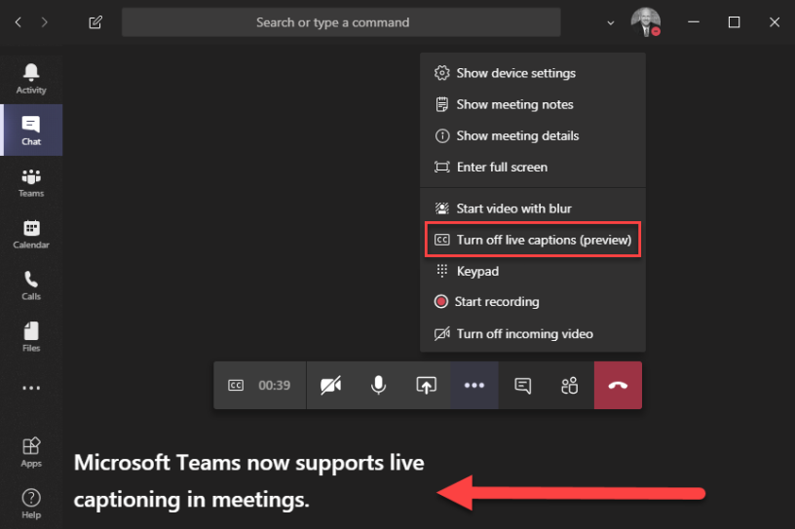
Benefits of using closed captioning during online meetings and trainings.
What are the two types of captioning?
Closed captions can be turned on or off with the click of a button.
Open captions are different from closed captions in that they are part of the clip itself and cannot be turned off.
Many people with disabilities find captions useful, as do students that have English as a second language.
Good practice: remind students and colleagues that they are available to use

Slide 11
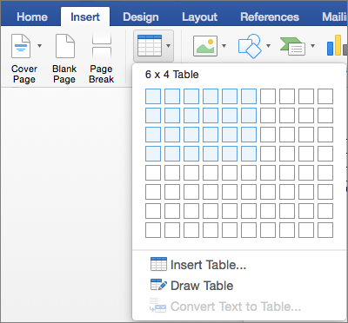
Accessible Tables within Documents
If tables are created using the insert a table feature in any Microsoft package they will be read correctly by a screen reader.
When tables are created using draw table, this is when the screen reader can have a difficulty reading the text in an order that is easily understood.
Avoid merging cells and splitting cells as this changes the original format of the table.

Slide 12
Checking your own work for accessibility is easily done
Select ‘check accessibility’ from the taskbar
The checker will point out what you have missed on your document or PowerPoint.
Click on the drop down arrows to change the reading order of your slide where necessary to support the use of screen readers.

Slide 13
Accessibility on PDF Documents
PDF documents are not as easily accessible.
They can be read by a screen reader however, students often need to be able to change the font/size in order to successfully access documents.
Adobe Acrobat Pro DC – is needed to use the accessibility checker in a PDF document.

Slide 14
Scanned Documents can be Problematic
When scanning documents to share with others it limits them to the way they were originally produced and they are therefore unable to be easily altered for accessibility.
Word documents are the most accessible format that we can use to support others as they can be adjusted to the correct font, size and spacing for the individual.

Slide 15
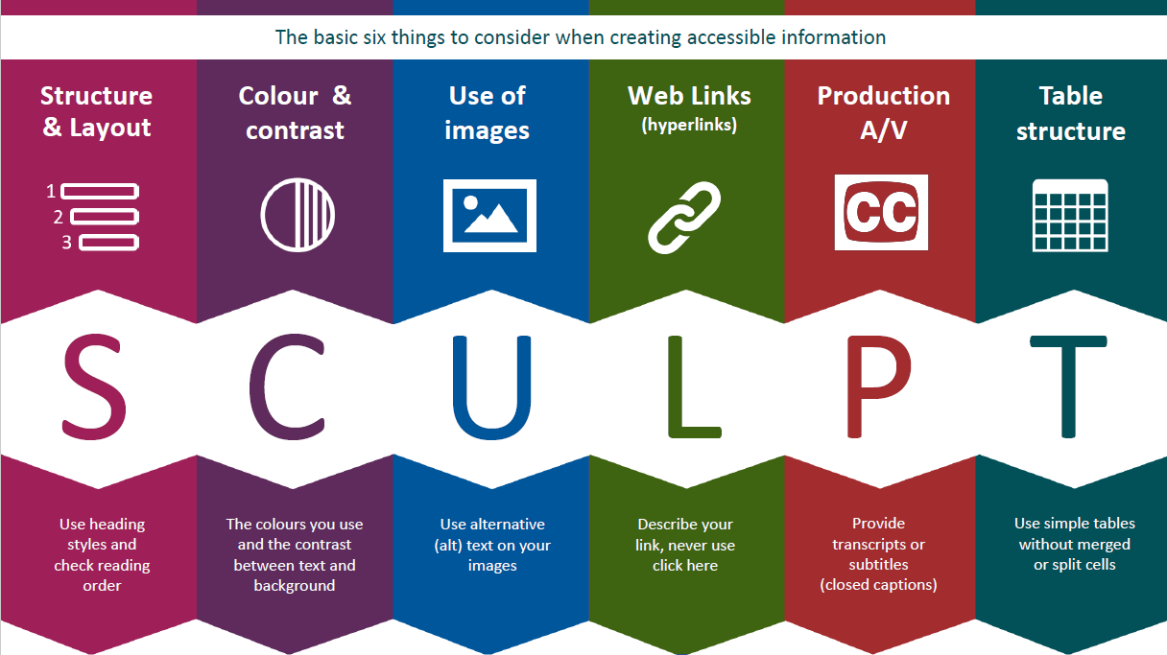
End of Presentation

