Slide 1
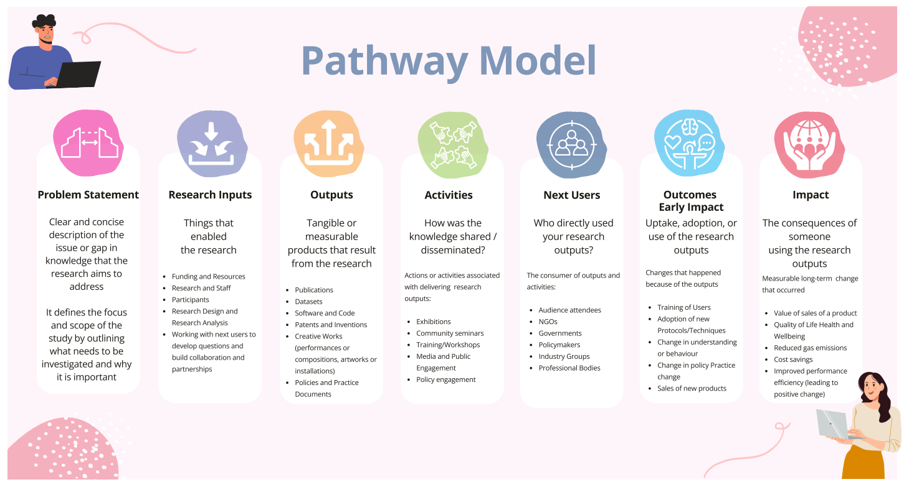

Slide 2
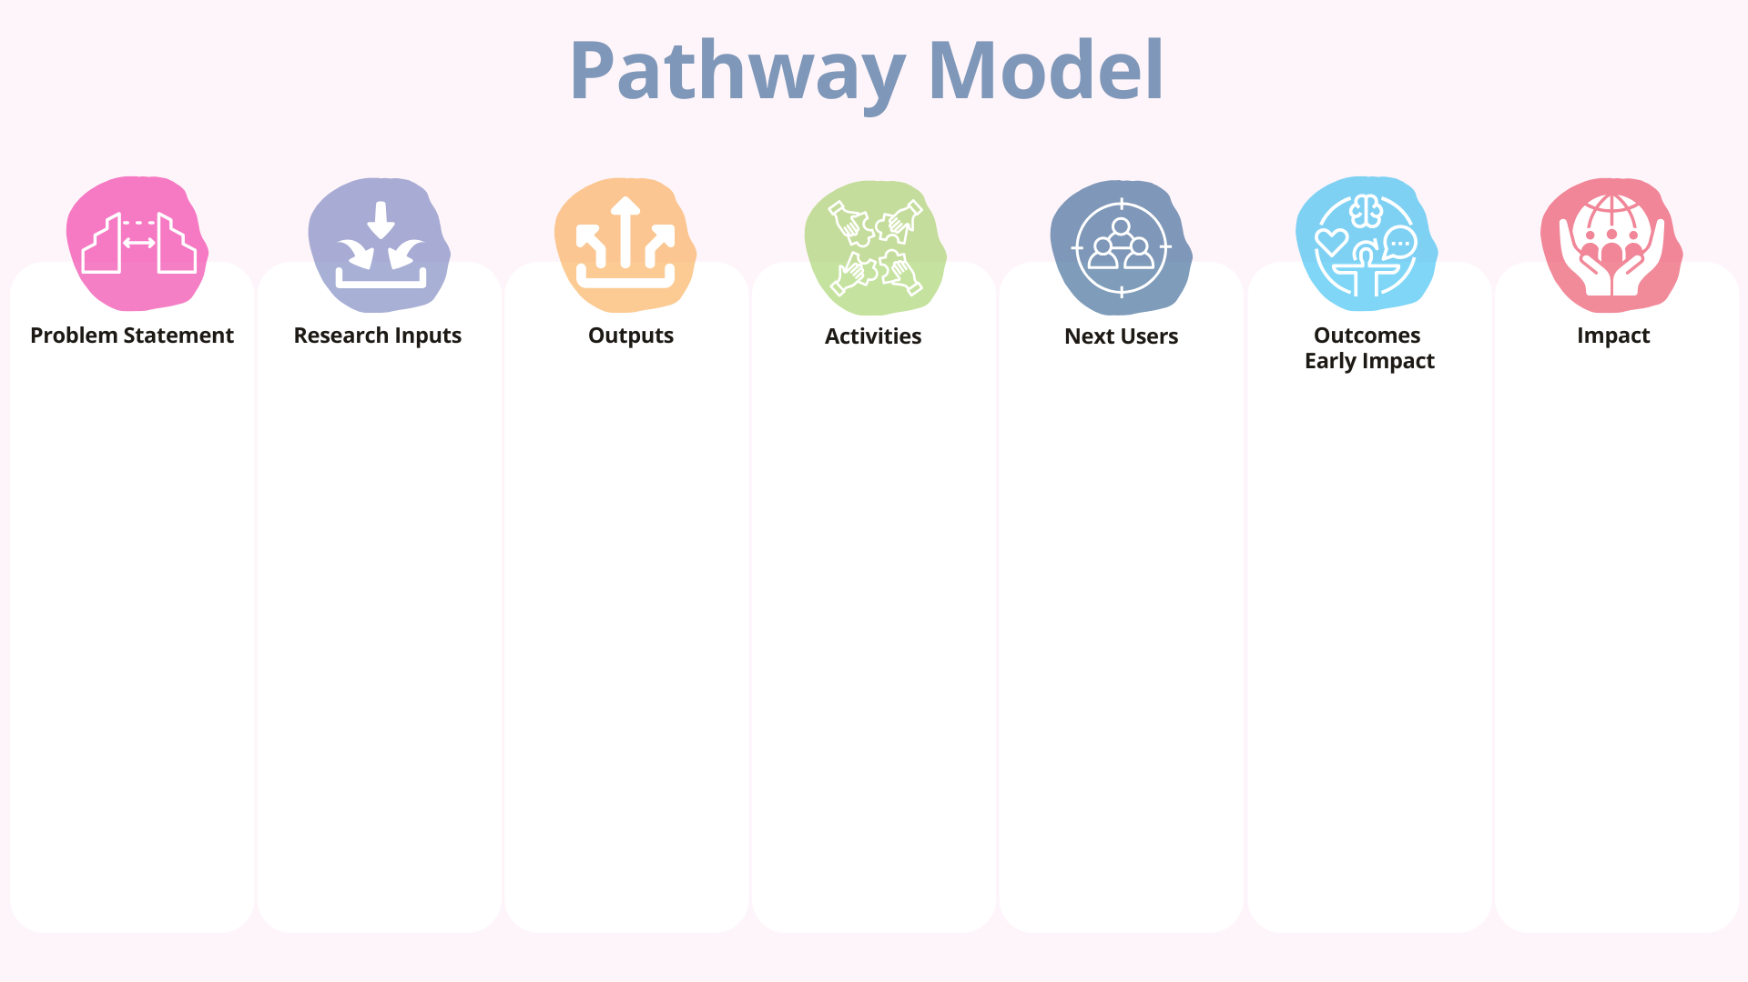
Funding and Resources: Grants from environmental NGOs and local government.
Research and Staff: Interdisciplinary team of urban planners, environmental scientists, and community organizers.
Participants: Residents of three pilot neighbourhoods, local NGOs, municipal representatives.
Research Design and Analysis: Mixed-methods approach including surveys, interviews, and participatory workshops.
Publications: Peer-reviewed articles outlining barriers and solutions for engagement.
Datasets: Community survey data and engagement tracking logs.
Creative Works: A photo exhibition showcasing successful local gardening stories.
Policies and Practice Documents: Toolkit for community-led urban gardening.
Exhibitions: Community photo gallery showcasing stories of local gardens.
Community Seminars: Held in pilot neighbourhoods to share findings and discuss strategies.
Training/Workshops: "Garden Leader" workshops to empower local champions.
Media and Public Engagement: Social media campaign featuring success stories and tips.
Policy Engagement: Briefings with city council and local policy working groups.
Audience Attendees: Residents attending seminars and workshops.
NGOs: Local organizations promoting food justice and sustainability.
Governments: City planning and public health departments.
Policymakers: Municipal leaders and urban agriculture advocates.
Industry Groups: Urban farming networks and green infrastructure suppliers.
Improved Quality of Life: Residents report better mental well-being and access to fresh produce.
Cost Savings: Reduced spending on fresh food for participating families.
Reduced Emissions: Decrease in food transportation due to local sourcing.
Improved Performance Efficiency: Local NGOs more effectively run engagement campaigns using the research toolkit.
Urban gardening initiatives in low-income neighbourhoods often face low community engagement, which undermines their sustainability and potential benefits. Key barriers include a lack of accessible knowledge, limited participation mechanisms, and insufficient policy support. This research addresses the gap by identifying effective strategies for improving engagement and long-term participation.
Training of Users: 30 local residents trained as garden leaders.
Adoption of New Protocols: Neighbourhoods implemented new volunteer management and event strategies.
Change in Understanding/Behaviour: Increased resident participation in garden planning and maintenance.
Policy Change: Inclusion of community gardening in the city’s urban greening strategy.
Practice Change: Three neighbourhoods report sustained garden activity with increased volunteer retention.
Sales of New Products: Local vendors begin selling garden toolkits developed from project insights.

Slide 3
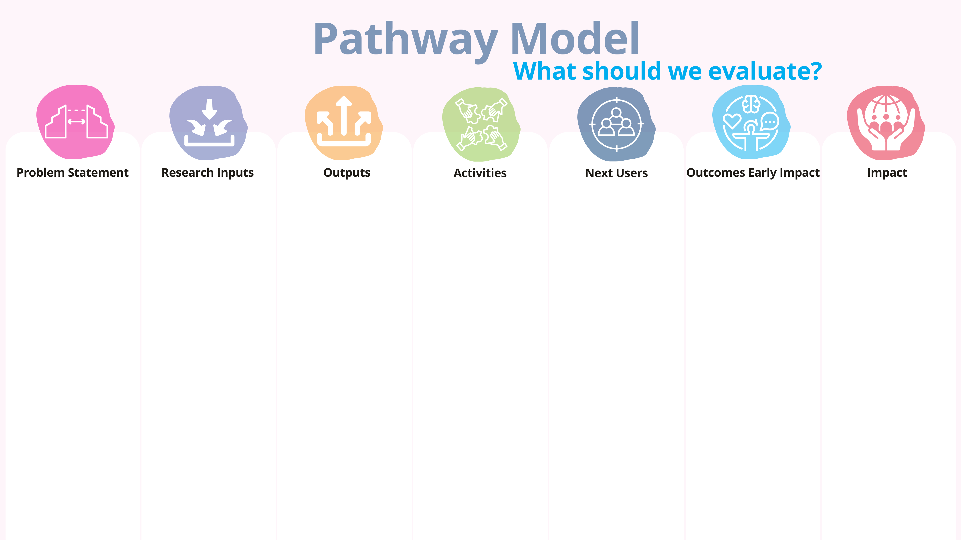
Evaluation Objective: ​
Understand baseline barriers to urban gardening and define change targets.​
​
Evaluation Actions:​
Conduct baseline surveys and interviews with residents, NGOs, and municipal staff.​
Identify knowledge gaps, current participation rates, and policy support levels.​
Align evaluation goals with the identified problem: enhancing engagement and sustainability.
Evaluation Objective:​
Assess whether inputs are sufficient and effectively used.​
​
Key Indicators:​
Quantity and quality of funding received.​
Diversity and expertise of interdisciplinary teams.​
Stakeholder (residents, NGOs) participation levels.​
​
Evaluation Actions:​
Track budget allocation and resource utilization.​
Document stakeholder involvement (attendance, diversity, contribution).​
Monitor engagement in surveys and participatory workshops.​
Evaluation Objective: ​
Determine if outputs are produced as intended and are relevant.​
​
Key Indicators:​
• Number of publications, datasets, and toolkits produced.​
• Audience reach of exhibitions and media campaigns.​
​
Evaluation Actions:​
• Content analysis of publications and toolkits.​
• Attendance records and feedback from public exhibitions.​
• Metrics from online campaign engagement (e.g., likes, shares, comments).​
Evaluation Objective: ​
Evaluate effectiveness and engagement in project activities.​
Key Indicators:​
Number of seminars, workshops, and briefings held.​
Attendance rates and participant feedback.​
Number and diversity of stakeholders involved.​
​
Evaluation Actions:​
Use pre/post surveys at each event to assess knowledge gain and satisfaction.​
Collect case stories from participants (qualitative).​
Monitor event logistics and participation demographics.​
Evaluation Objective: ​
Track use and uptake of research and resources.​
Key Indicators:​
Number of organizations or departments adopting strategies.​
Follow-up activities by NGOs, governments, and policymakers.​
​
Evaluation Actions:​
Conduct follow-up interviews or surveys with user groups.​
Track usage metrics of toolkits and resources.​
Assess media citations or policy references to the project.​
Evaluation Objective:​
Measure behavioural, procedural, and policy changes.​
​
Key Indicators:​
Number of garden leaders trained and active.
Increase in resident participation and volunteer retention.​
Adoption of new event/volunteer protocols.
Changes in city policies and neighbourhood practices.​
​
Evaluation Actions:​
Before-and-after comparison of engagement logs and volunteer hours.​
Qualitative interviews with trained leaders and community members.​
Review municipal plans for integration of community gardening strategies.​
Evaluation Objective: ​
Capture sustained benefits for individuals and communities.​
Key Indicators:​
Improved mental well-being and access to fresh food (self-reported).​
Household cost savings on fresh produce.​
Reduction in food transportation emissions.​
Increased NGO capacity and efficiency.​
​
Evaluation Actions:​
Longitudinal surveys on health, well-being, and food spending.​
Environmental impact estimates using sourcing and transportation data.​
Organizational assessments with NGOs on toolkit usage and outcomes.

Slide 4
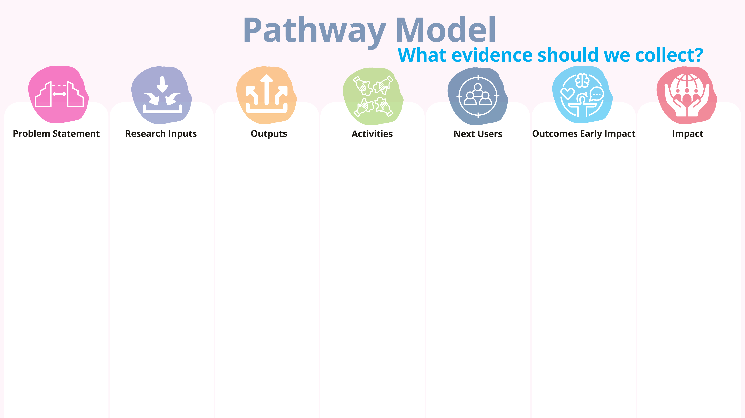
Evidence to Collect:​
Baseline understanding of community engagement challenges.​
Barriers related to knowledge access, participation, and policy support.​
Indicators:​
% of residents aware of urban gardening benefits.​
% of residents participating in gardening prior to project.​
Existing city policies on community gardening.​
Sources:​
Baseline community surveys and interviews.​
Municipal policy documents.​
NGO reports or case studies.​
Evidence to Collect:​
Funding and staff commitment.​
Participant demographics and project roles.​
Research methods and participation levels.​
Indicators:​
Number and type of funding sources.​
Number and roles of interdisciplinary staff involved.​
Number and diversity of participants from pilot neighbourhoods.​
Sources:​
Grant applications and financial records.​
Project team logs or time sheets.​
Attendance and demographic records from workshops and surveys.​
Evidence to Collect:​
Publications and public-facing materials.​
Community datasets and creative works.​
Tools and policy briefs developed.​
Indicators:​
Number of published articles and toolkits.​
Dataset completeness (response rate, coverage).​
Event attendance or toolkit downloads/views.​
Sources:​
Publication repositories (journals, project website).​
Internal logs of datasets and reports.​
Digital engagement metrics (social media, downloads).​
Feedback forms from exhibitions and photo galleries.​
Evidence to Collect:​
Events conducted and participation levels.​
Workshop engagement and learning outcomes.​
Media coverage and policy briefings.​
Indicators:​
Number of seminars/workshops/media posts.​
Pre/post workshop knowledge assessments.​
Number of policy briefings conducted, and stakeholders reached.​
Sources:​
Sign-in sheets and participant surveys.​
Event reports and photos/videos.​
Media analytics (e.g., likes, shares, coverage).​
Policy engagement logs.​
Evidence to Collect:​
Organizations using the research or toolkit.​
New strategies adopted by institutions or networks.​
Indicators:​
Number of NGOs/government bodies adopting practices.​
Number of references to project tools in external reports or strategies.​
Sources:​
Follow-up interviews with NGOs/government partners.​
Usage logs or requests for toolkit access.​
Mentions in policy, NGO, or academic documentation.​
Evidence to Collect:​
Change in resident behaviour and engagement.​
Changes in neighbourhood volunteer models.​
Inclusion of gardening in local policies.​
Indicators:​
Number of garden leaders trained and active.​
Increase in volunteer hours and retention.​
Policy revisions reflecting community gardening.​
Sources:​
Garden leader training completion logs and interviews.​
Volunteer tracking data (before/after).​
City council meeting minutes and revised policy documents.​
Evidence to Collect:​
Resident health and financial outcomes.​
Environmental impact and NGO effectiveness.​
Indicators:​
% of residents reporting improved well-being and food access.​
Average monthly savings on fresh food per household.​
Estimated reduction in emissions.​
Improved outreach performance by NGOs.​
Sources:​
Longitudinal resident surveys and interviews.​
Grocery receipts or expenditure diaries.​
Environmental modelling tools (based on sourcing data).​
NGO campaign performance reports (pre/post toolkit use).

Slide 5
Text here
Text here
Text here
Text here
Text here
Text here
Text here

