Slide 1
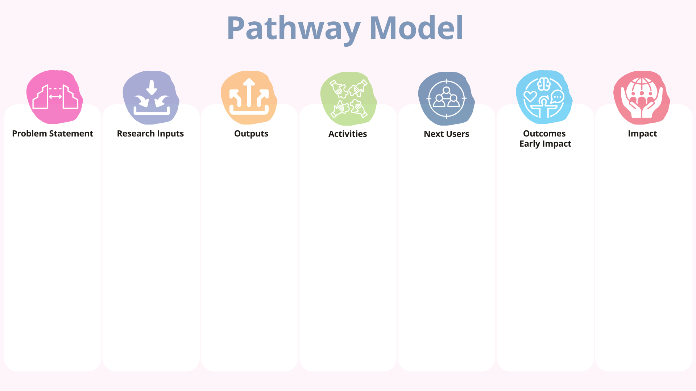
Funding and Resources: Grants from environmental NGOs and local government.
Research and Staff: Interdisciplinary team of urban planners, environmental scientists, and community organizers.
Participants: Residents of three pilot neighbourhoods, local NGOs, municipal representatives.
Research Design and Analysis: Mixed-methods approach including surveys, interviews, and participatory workshops.
Publications: Peer-reviewed articles outlining barriers and solutions for engagement.
Datasets: Community survey data and engagement tracking logs.
Creative Works: A photo exhibition showcasing successful local gardening stories.
Policies and Practice Documents: Toolkit for community-led urban gardening.
Exhibitions: Community photo gallery showcasing stories of local gardens.
Community Seminars: Held in pilot neighbourhoods to share findings and discuss strategies.
Training/Workshops: "Garden Leader" workshops to empower local champions.
Media and Public Engagement: Social media campaign featuring success stories and tips.
Policy Engagement: Briefings with city council and local policy working groups.
Audience Attendees: Residents attending seminars and workshops.
NGOs: Local organizations promoting food justice and sustainability.
Governments: City planning and public health departments.
Policymakers: Municipal leaders and urban agriculture advocates.
Industry Groups: Urban farming networks and green infrastructure suppliers.
Improved Quality of Life: Residents report better mental well-being and access to fresh produce.
Cost Savings: Reduced spending on fresh food for participating families.
Reduced Emissions: Decrease in food transportation due to local sourcing.
Improved Performance Efficiency: Local NGOs more effectively run engagement campaigns using the research toolkit.
Urban gardening initiatives in low-income neighbourhoods often face low community engagement, which undermines their sustainability and potential benefits. Key barriers include a lack of accessible knowledge, limited participation mechanisms, and insufficient policy support. This research addresses the gap by identifying effective strategies for improving engagement and long-term participation.
Training of Users: 30 local residents trained as garden leaders.
Adoption of New Protocols: Neighbourhoods implemented new volunteer management and event strategies.
Change in Understanding/Behaviour: Increased resident participation in garden planning and maintenance.
Policy Change: Inclusion of community gardening in the city’s urban greening strategy.
Practice Change: Three neighbourhoods report sustained garden activity with increased volunteer retention.
Sales of New Products: Local vendors begin selling garden toolkits developed from project insights.

Slide 2
Text here
Text here
Text here
Text here
Text here
Text here
Text here

